Slide 1

FAKE NEWS DETECTION
AUTHORS:
Călinescu Valentin
Zugravu Andrei
Lupașcu Marian

Slide 2
Content
Introduction
Related work – datasets
Related work – methods
Dataset
SECTION ONE
SECTION TWO
SECTION THREE
SECTION FOUR
Model 1 – SVM
Model 2 – Naïve Bayes
Model 3 – Logistic Regression
Conclusion
SECTION FIVE
SECTION SIX
SECTION SEVEN
SECTION EIGHT

Slide 3
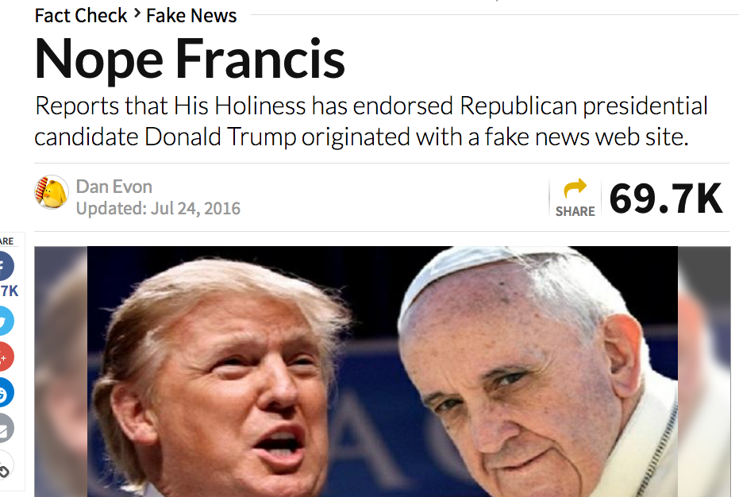
Introduction
over 4 million YouTube videos watched every minute
over 500,000 comments, photos and tweets posted per minute continuously
there is no practical way of controlling all the information that is spread out there
we witness the rise of fake news
it is not feasible for a group of people, no matter how big, to classify the news in real and fake
we need to use computers to our advantage
Figure 1: Fake news example

Slide 4
Related work – datasets
Ma et al. (2016) collected 5 million posts from Twitter
Sina Weibo collected micro blogs that comprised 778 reported events from which 64% are rumors
The FA-KES dataset comprises news events around the Syrian war (Salem et al., 2019) - 804 news articles of which 376 are fake

Slide 5
Related work – methods
0
1
2
3
4
Ahmad et. al
(ISOT Fake News Dataset) - 99%, achieved by random forest algorithm and Perez-LSVM.
Nasir et. al
Hybrid CNN-RNN method
FA-KES dataset – 60%
ISOT dataset – 99%
Zellers et. al
analyze the use of multiple high-end models for fake news detection, suggesting a unidirectional model, called Grover, may be the best (92%)
Bhatt et al
83.08% - Fake News Challenge,
suggest that one class of methods isn’t enough, and proposes a combination of neural and statistical methods
While Thota et al.
94.21% - Fake News Challenge
used NN architectures

Slide 6

Dataset
the dataset used was taken from Kaggle (https://www.kaggle.com/samrat96/fake-news-detection )
contains approximately 25k train samples
5.8k test samples
where the label is either 1 or 0 (1-Real News 0-Fake News).

Slide 7
Model 1 – SVM
Model | Bow/TF-IDF | Stemming | Stop words removal | Accuracy
SVM | TF-IDF | NO | YES | 97.83%
 | TF-IDF | NO | NO | 96.97%
 | TF-IDF | YES | YES | 95.91%
 | TF-IDF | YES | NO | 95.52%
 | BOW | NO | YES | 94.42%
 | BOW | NO | NO | 95.52%
 | BOW | YES | YES | 92.98%
 | BOW | YES | NO | 92.78%

Slide 8
Model 2 – Naïve Bayes
Model | Bow/TF-IDF | Stemming | Stop words removal | Accuracy
Naïve Bayes | TF-IDF | NO | YES | 90.38%
 | TF-IDF | NO | NO | 91.15%
 | TF-IDF | YES | YES | 89.71%
 | TF-IDF | YES | NO | 88.36%
 | BOW | NO | YES | 89.9%
 | BOW | NO | NO | 91.49%
 | BOW | YES | YES | 86.82%
 | BOW | YES | NO | 87.78%

Slide 9
Model 3 – Logistic Regression
Model | Bow/TF-IDF | Stemming | Stop words removal | Accuracy
Logistic Regression | TF-IDF | NO | YES | 96.34%
 | TF-IDF | NO | NO | 95.33%
 | TF-IDF | YES | YES | 94.18%
 | TF-IDF | YES | NO | 94.8%
 | BOW | NO | YES | 96.15%
 | BOW | NO | NO | 96.44%
 | BOW | YES | YES | 93.94%
 | BOW | YES | NO | 94.37%

Slide 10
Conclusion
Model | Bow/TF-IDF | Stemming | Stop words removal | Accuracy
SVM | TF-IDF | NO | YES | 97.83%
Naïve Bayes | BOW | NO | NO | 91.49%
Logistic Regression | BOW | NO | NO | 96.44%
BERT | Intern | Intern | NO | 99.23%

Slide 11

Q&A

Slide 12

Thank you!

